Slide 1
30
Pㄹㄹㄹㄹ
2026 BioPhys summer school
Markov chain 101
Dongho Lee | 26.07.01
Notes:
Today, I will talk about a possible proposal direction on target search dynamics in phase-separated systems.
The main focus is not how LLPS itself occurs, or how condensates are formed.
Instead, I want to ask what happens after a condensate, or more generally a phase-separated compartment, already exists.
In particular, I am interested in how transport heterogeneity inside and outside the condensate affects single-molecule target search.

Slide 2
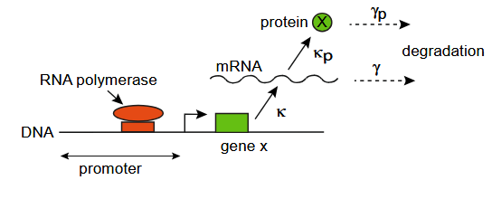
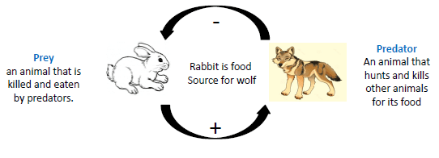
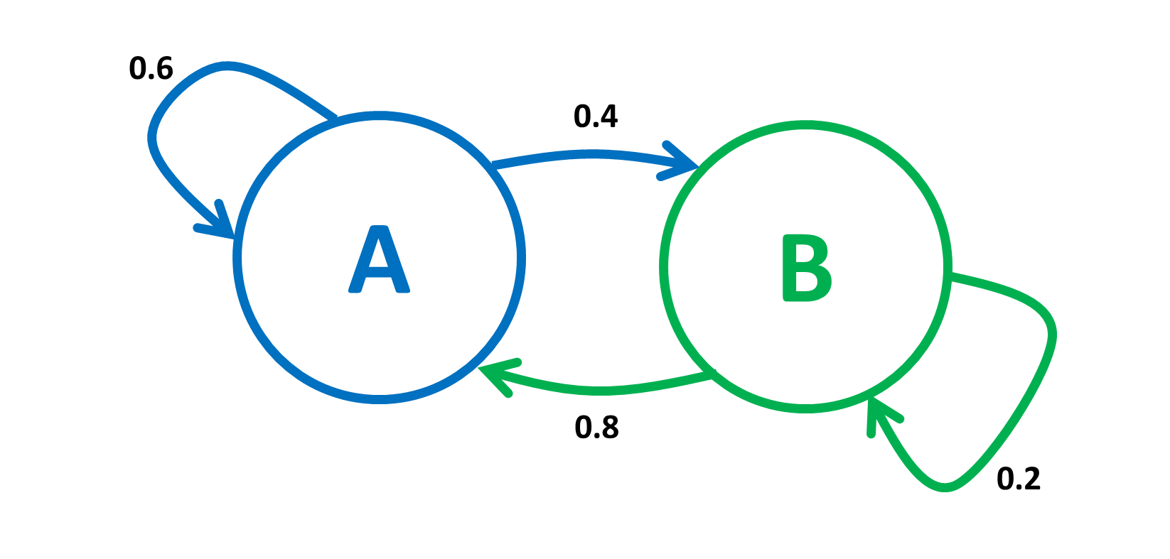
Stochastic processes in living cells
Random transition to another states
States are discrete
(micro-scale)
Molecules (states) are memoryless
(macro-scale)
How to model such system?
Fluctuation exists in biological processes:
Markov chain.
Biological process occurs with finite number of events/individual;
And the events includes many probabilistic factors.
Therefore, modeling such system requires ‘stochasticity’

Slide 3
Contents
Definition of DTMC
Discrete-time Markov chain (DTMC)
Simulation
Example – Evolutionary population genetics
Definition of CTMC
Continuous-time Markov chain (CTMC)
Simulation
Example – Birth and death model / Chemical reaction network

Slide 4
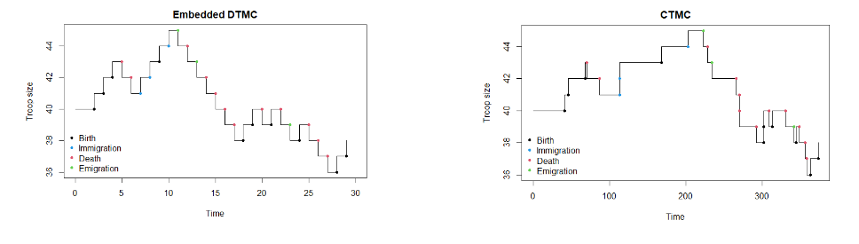
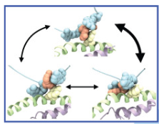
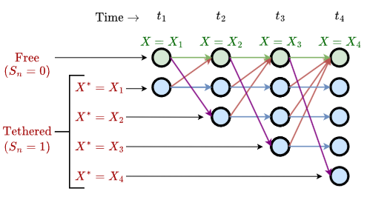
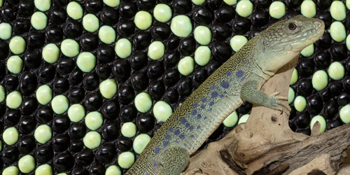
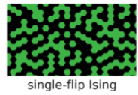
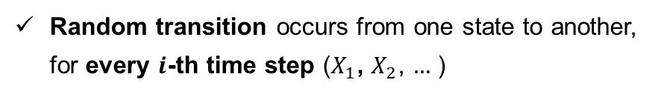
Discrete-time Markov chain (DTMC)
DTMC $X_{i}$ is stochastic process of discrete state $X$,
Random transition occurs from one state to another, for every $i$-th time step ($X_{1}$, $X_{2}$, $…$ )
Transition depends only on current state
GOAL: Learn definition of DTMC Run simulation scheme of DTMC
(“Markov property”: Molecules are memoryless)
Use for discrete state, discrete-time observation (exp):
Protein dynamics
Simulate patterning
State inference (hidden Markov model)
Population dynamics (generation) & Genetics (generation)
Random walk
Protein folding, gene regulation,…
Notes:
Transition 정의

Slide 5
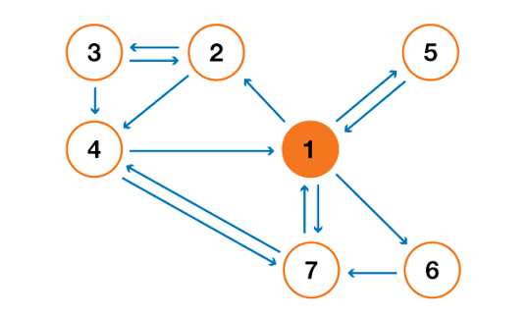
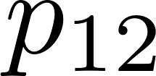
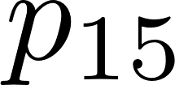
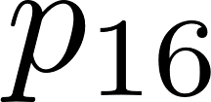
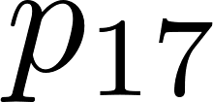
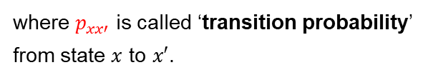
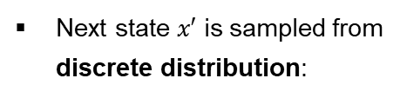
Definition of DTMC
Definition
Stochastic process $X_{i}$ (discrete time $i$ & finite states) is DTMC if:
“Markov property”
Define a DTMC ‘uniquely’
(Start from state 1,)
Where to jump?
Next state $x′$ is sampled from discrete distribution:
where $p_{xx′}$ is called ‘transition probability’ from state $x$ to $x′$.
Notes:
Exponential waiting time
Definie

Slide 6
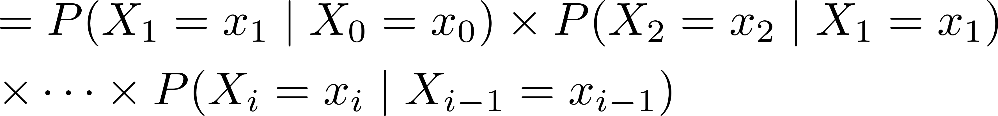
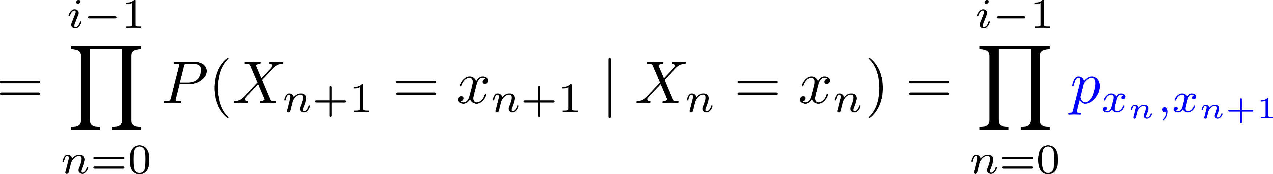

Definition of DTMC
Define a DTMC ‘uniquely’
Where to jump?
(Start from state 1,)
Probability of ‘trajectory’:
“Markov property”
$p_{xx′}$ fully characterizes DTMC!
Notes:
Exponential waiting time
Definie

Slide 7
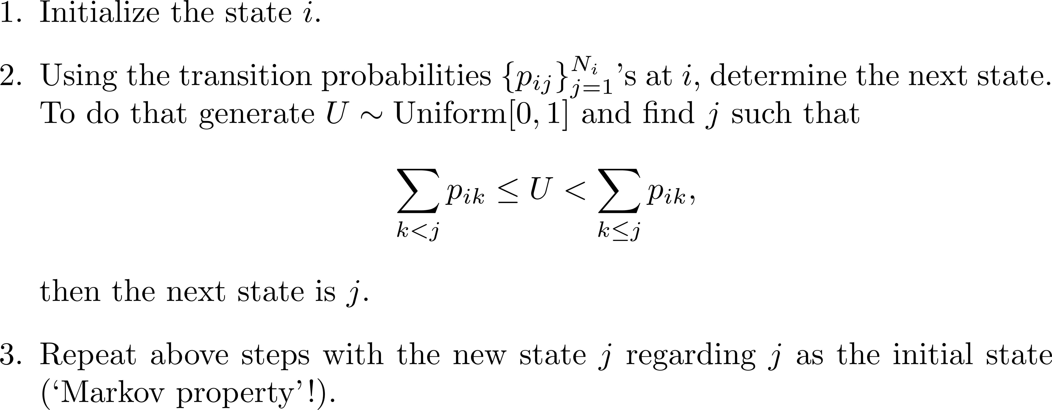
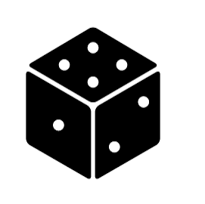


Simulation
Step-by-step

Slide 8
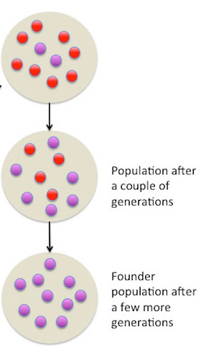
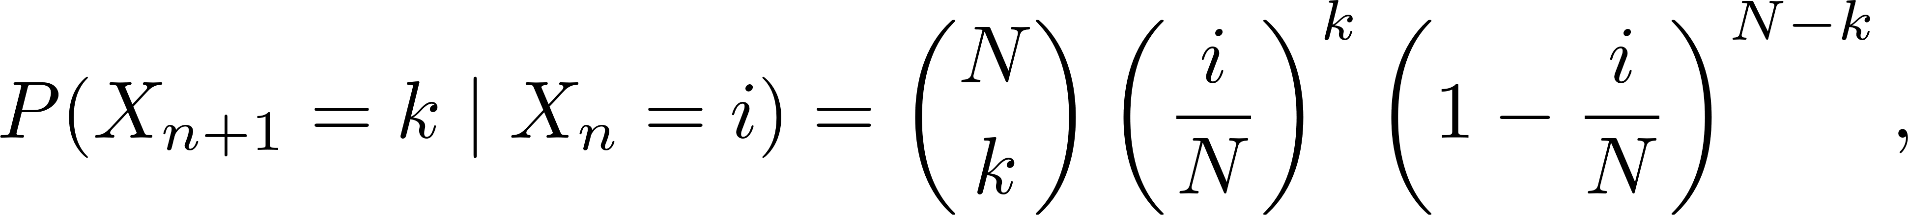

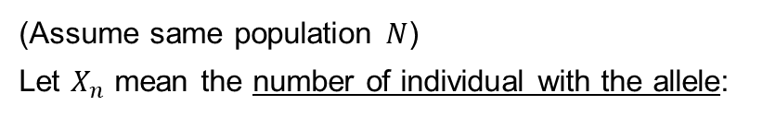
Example – Evolutionary population genetics
Model
Does specific allele remain after a few generations?
Allele (red)
(Assume same population $N$) Let $X_{n}$ mean the number of individual with the allele:
where each individual inherits the allele with $p=X_{n}/N$
Task 1: Simulate trajectory $X_{n}$

Slide 9
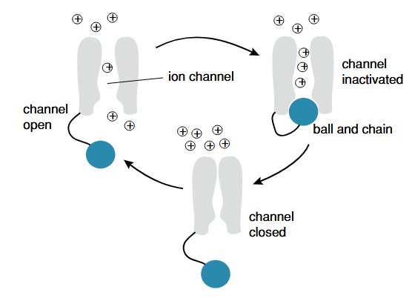
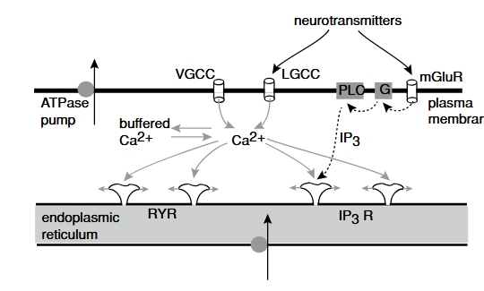
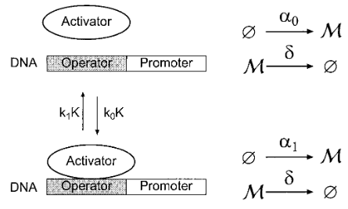
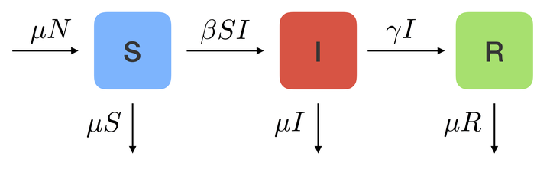
Continuous-time Markov chain (CTMC)
CTMC is same with DTMC, except the transition occurs in continuous random time
GOAL: Learn definition of CTMC Run simulation scheme of CTMC
Use for discrete state, continuous time (modeling reactions):
Ion channel
Transcription regulation
Signaling pathway
Infection dynamics
Notes:
DTMC는 일정한 시간 간격으로 transition이 일어나거나, 관찰할 수 있는 시간이 그 간격밖에 없음.
반면에 CTMC는 transition이 일어날 수 있는 시간이 ‘연속적인’ 임의의 값일 수 있음.
(예시 그림)

Slide 10

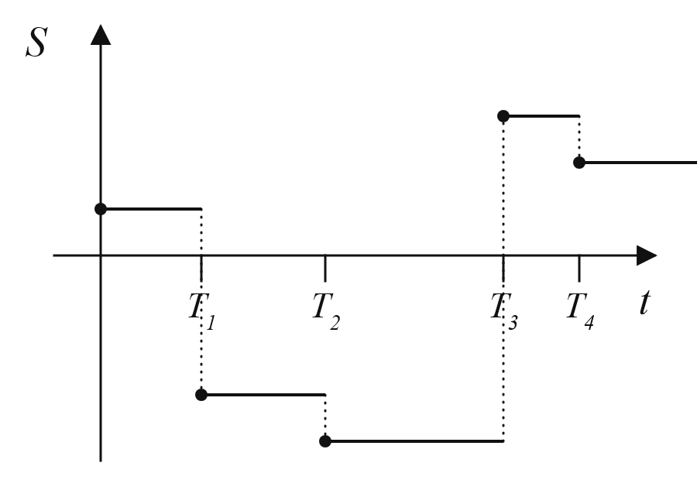

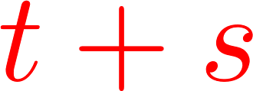
Definition of CTMC
Definition
Stochastic process $X(t)$ (continuous time $t$ & finite states) is CTMC if:
Markovian property (Cf. DTMC)

Slide 11

Definition of CTMC
Determine a CTMC ‘uniquely’
(Start from state 1 at time $t_{0}$,)
1. When to jump?
How long before the transition?
2. Where to jump?
Which state will it transition to?
Notes:
Exponential waiting time
Definie

Slide 12
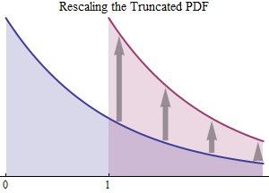
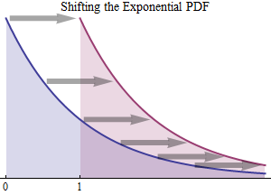
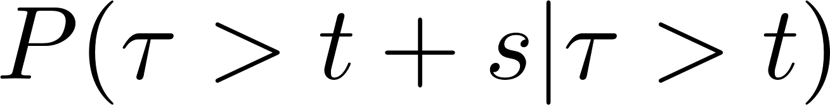
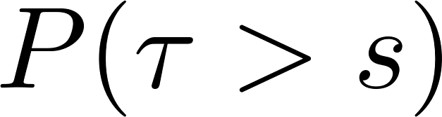



Definition of CTMC
When to jump?
(Given current state $X\left(t_{0}\right)=x$,) Waiting time $τ$ should be sampled from exponential distribution:
Waiting time $τ$
where $λ(x)$ is called ‘jump rate’ of state $x$. ($P(dt|x)≈λ\left(x\right)dt$)
Property of exponential distribution
Characterized by single parameter $λ$
Memoryless property:
Definition of $τ$ is free from $t_{0}$
Notes:
항상 남들보다 잘하기 보다는 어제의 나보다 더 나은 사람이 되자.

Slide 13
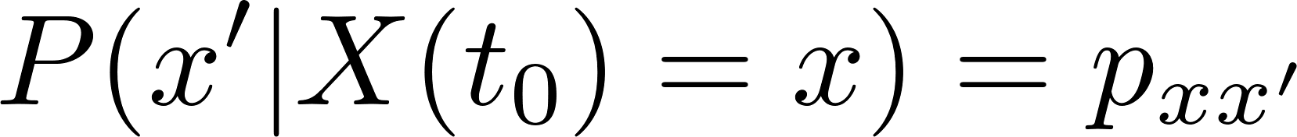
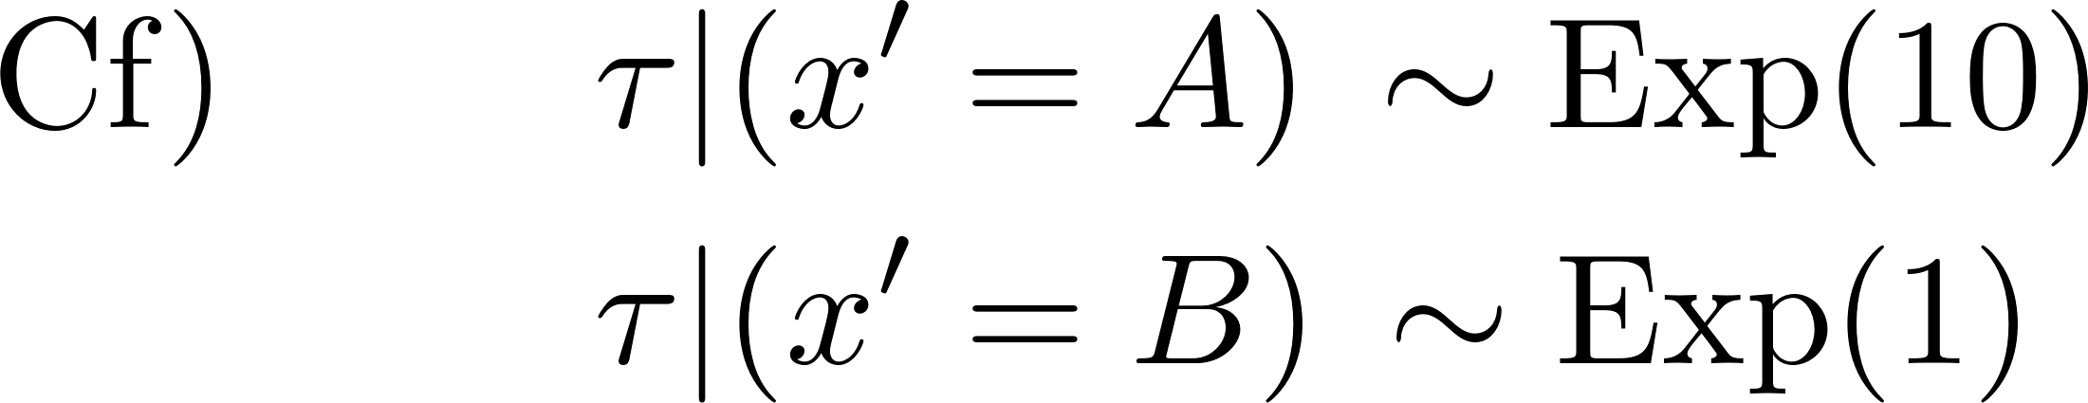




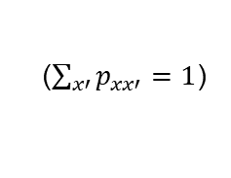
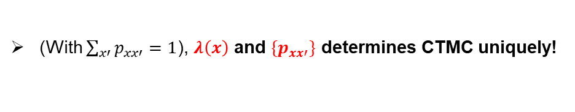
Definition of CTMC
Where to jump?
(Given current state $X\left(t_{0}\right)=x$,) Next state $x′$ is sampled from discrete distribution:
$$x′$$
$$p_{xx′}$$
where $p_{xx′}$ is called ‘transition probability’ from state $x$ to $x′$.
($\sum_{x′}{p_{xx′}}=1$)
$$x$$
Independency of next state ($x′$) and waiting time ($τ$)
Or not, memoryless/Markovian property will be broken!
Long $τ$ $→$ A is more probable
(With $\sum_{x′}{p_{xx′}}=1$), $λ\left(x\right)$ and ${\{p}_{xx′}\}$ determines CTMC uniquely!
Notes:
Exponential waiting time
Definie

Slide 14

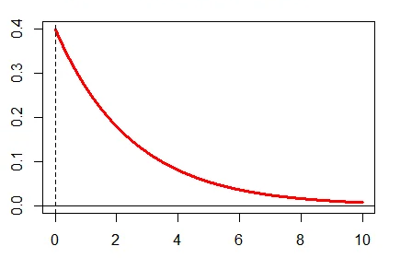




Definition of CTMC
Define a CTMC ‘uniquely’
1. When to jump?
‘jump rate’ $λ(x)$
2. Where to jump?
‘transition probability’ $p_{xx′}$
Notes:
Exponential waiting time
Definie

Slide 15
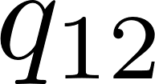
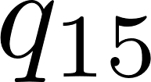
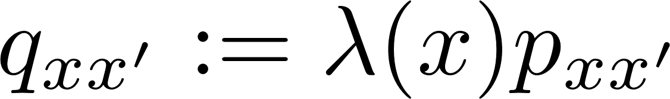
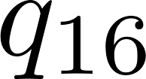
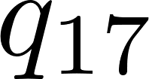
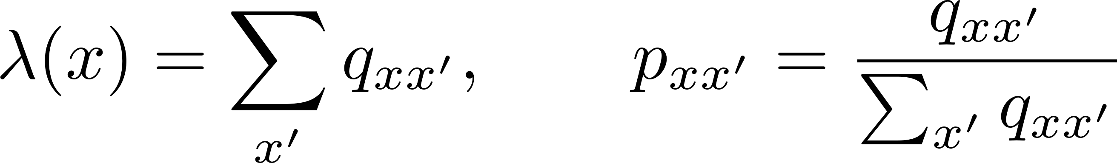




Definition of CTMC
Determine a CTMC ‘uniquely’
1. When to jump?
‘jump rate’ $λ(x)$
2. Where to jump?
‘transition probability’ $p_{xx′}$
‘Transition rate’ $q_{xx′}$
$P(X\left(t+dt\right)=x′|X\left(t\right)=x)≈λ(x)p_{xx′}Δt$
(independency)
Transition rate fully characterize CTMC!
Notes:
Exponential waiting time
Definie

Slide 16
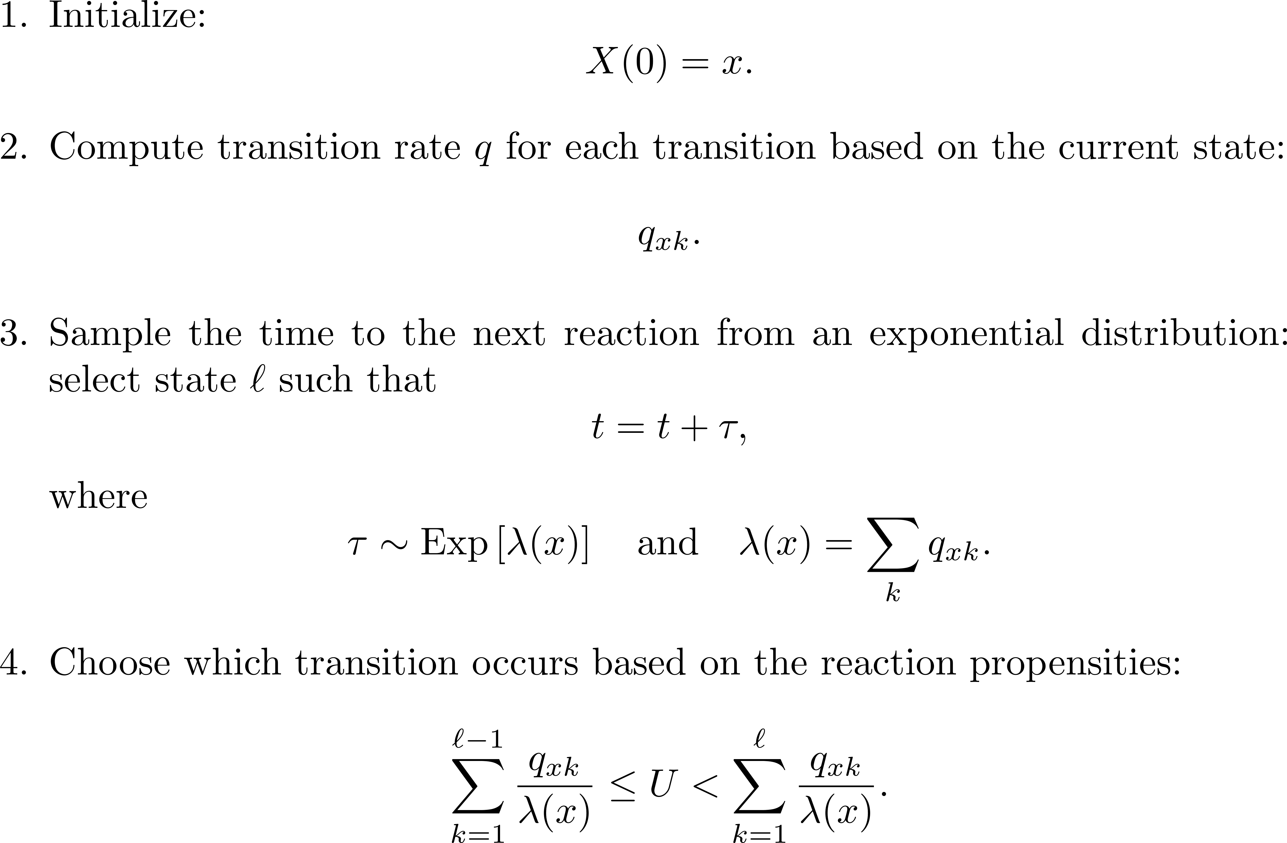
Simulation: Gillespie’s algorithm
Step-by-step

Slide 17
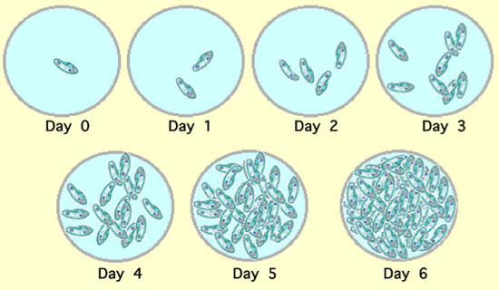
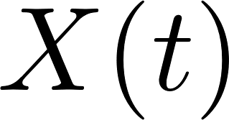
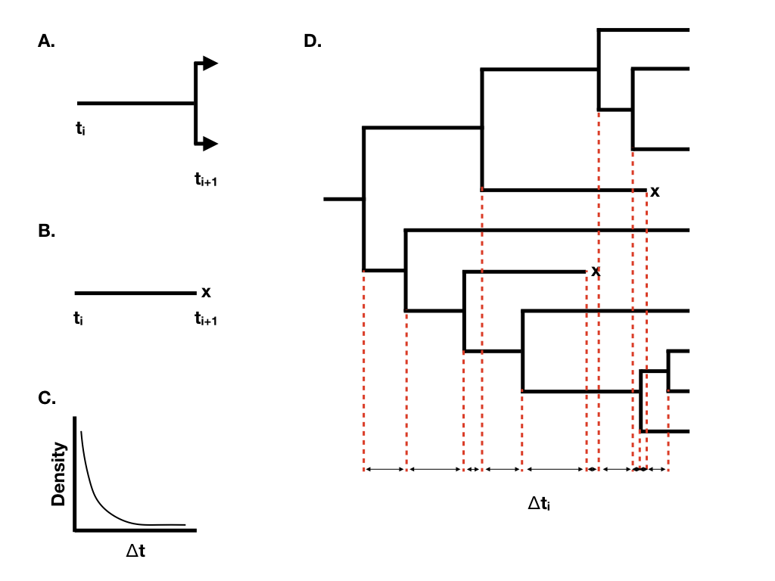
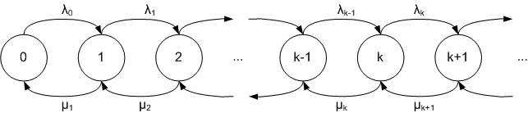
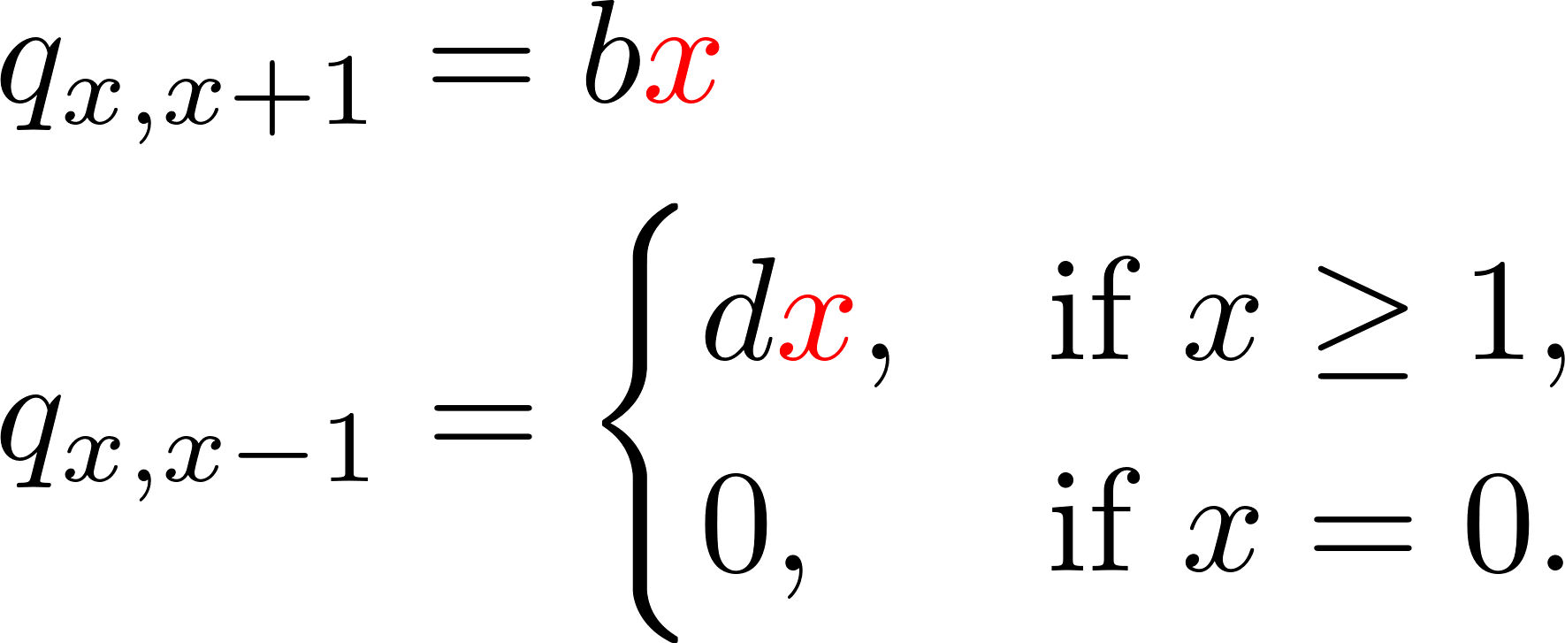
Example 1 - Birth and death model
Model
Simplest model of species population
Ex) Bacteria population
Birth
Single trajectory
CTMC modeling
Death
Exponential waiting time
Notes:
Exponential waiting time
Definie

Slide 18




Example 1 - Birth and death model
Simulation task
Task 2: Estimate distribution $P(X, t)$
Task 3: Estimate moment $\left\langle X\left(t\right)\right\rangle$, $\left\langle X^{2}\left(t\right)\right\rangle$
Cf 1) DTMC case
Cf 2) deterministic equation

Slide 19





Example 2 - Chemical reaction network (CRN)
How to simulate chemical reaction with fluctuation?
Ex) Cell signal pathway
Example: 2-species reaction
B
(a+1, b+1)
Reaction 2
Transition rates:
‘mass-action law’
(a, b)
Reaction 1 : $q_{\left(a, b\right)→(a−1, b−1)}=k_{1}×a×b$
Reaction 3
Reaction 2 : $q_{\left(a, b\right)→(a+1, b+1) }=k_{2}$
Reaction 1
Reaction 3 : $q_{\left(a, b\right)→(a+1, b−1)}=k_{3}×a×\frac{b(b−1)}{2}$
(a-1, b-1)
(a+1, b-1)
A

Slide 20


Example 2 - Chemical reaction network (CRN)
Simulation task: Practice CRNs
Task 4: Complete code & simulate
Task 5: Does it return to origin?

Slide 21
Thanks for listening!

Slide 22



About our lab
Theoretical Biophysics and Non-equilibrium Statistical Physics Lab
Principle Investigator: Prof. Jae-Hyung Jeon
Associate Professor | Department of Physics
APCTP Executive Director
Email: jeonjh@postech.ac.kr or jeonjh@gmail.com
tbio.postech.ac.kr

